Slide 1

FIRST Principles
Dr. Siobhán Drohan (sdrohan@wit.ie)
Eamonn de Leastar (edeleastar@wit.ie)
Produced
by:
Department of Computing and Mathematics
http://www.wit.ie/

Slide 2

FIRST Principles
Characteristics of quality tests:
[F]ast
[I]solate your tests
[R]epeatable
[S]elf-validating
[T]imely
Source Code: https://pragprog.com/titles/utj2/source_code

Slide 3

[F]IRST: [F]ast
Consider this scenario:
2500 unit tests
Average test takes 200 ms
→ approx. 8 minutes to run test suite.
Are you going to run an 8-minute suite of tests multiple times a day?

Slide 4
[F]IRST: [F]ast
Consider this scenario:
2500 unit tests
Average test takes 200 ms
→ approx. 8 minutes to run test suite.
Are you going to run an 8-minute suite of tests multiple times a day?
As your system grows, your unit tests will take longer and longer to run: 8 minutes easily turns into 15 or even 30.

Slide 5
[F]IRST: [F]ast
Tipping Point: When your unit tests reach the point where it’s painful to run them more than a couple times per day, you’ve tipped the scale in the wrong direction.

Slide 6
[F]IRST: [F]ast
Tipping Point: When your unit tests reach the point where it’s painful to run them more than a couple times per day, you’ve tipped the scale in the wrong direction.
Value/Health Diminishes: The value of your suite of unit tests diminishes as their ability to provide continual, comprehensive, and fast feedback about the health of your system also diminishes.

Slide 7
[F]IRST: [F]ast
Tipping Point: When your unit tests reach the point where it’s painful to run them more than a couple times per day, you’ve tipped the scale in the wrong direction.
Value/Health Diminishes: The value of your suite of unit tests diminishes as their ability to provide continual, comprehensive, and fast feedback about the health of your system also diminishes.
Confidence Diminishes: When you allow your tests to fall out of favour, you and your team will question the investment you made to create them.

Slide 8
[F]IRST: [F]ast → Recommendations
Keep your tests fast!
Keep your design clean
minimize the dependencies on code that executes slowly.

Slide 9
[F]IRST: [F]ast → Recommendations
Keep your tests fast!
Keep your design clean
minimize the dependencies on code that executes slowly.
If all your tests interact with code that ultimately always makes a database call, all your tests will be slow.
This is where the Mock Objects technique can excel (more on this later).

Slide 10
FIRST Principles
Characteristics of quality tests:
[F]ast
[I]solate your tests
[R]epeatable
[S]elf-validating
[T]imely
Source Code: https://pragprog.com/titles/utj2/source_code

Slide 11
F[I]RST: [I]solate your tests
Good unit tests focus on a small chunk of code to verify (i.e. cohesive):
That’s in line with our definition of unit; the more code that your test interacts with, directly or indirectly, the more things are likely to go awry.

Slide 12
F[I]RST: [I]solate your tests
Good unit tests focus on a small chunk of code to verify (i.e. cohesive):
That’s in line with our definition of unit; the more code that your test interacts with, directly or indirectly, the more things are likely to go awry.
You should be able to run any one test at any time, in any order:
Good unit tests also don’t depend on other unit tests (or test cases within the same test method). You might think you’re speeding up your tests by carefully crafting their order so that several tests can reuse some of the same expensively constructed data. But you’re simultaneously creating an evil chain of dependencies. When things go wrong—and they will—you’ll spend piles of time figuring out which one thing buried in a long chain of prior events caused your test to fail.

Slide 13
F[I]RST: [I]solate your tests
Single Responsibility Principe (SRP) and Testing:
SRP: classes should have only one reason to change.

Slide 14
F[I]RST: [I]solate your tests
Single Responsibility Principe (SRP) and Testing:
SRP: classes should have only one reason to change.
SRP provides great guideline for your test methods also. If one of your test methods can break for more than one reason, consider splitting it into separate tests. When a focused unit test breaks, it’s usually obvious why.

Slide 15
F[I]RST: [I]solate your tests
Single Responsibility Principe (SRP) and Testing:
SRP: classes should have only one reason to change.
SRP provides great guideline for your test methods also. If one of your test methods can break for more than one reason, consider splitting it into separate tests. When a focused unit test breaks, it’s usually obvious why.
It’s easy to keep your tests focused and independent if each test concentrates only on a small amount of behaviour.
When you start to add a second assert to a test, ask yourself, “Does this assertion help to verify a single behaviour, or does it represent a behaviour that I could describe with a new test name?”

Slide 16
F[I]RST: [I]solate your tests
Consider this database access scenario:
The code you’re testing might interact with other code that reads from a database.
Data dependencies create a whole host of problems. Tests that must ultimately depend on a database require you to ensure that the database has the right data.
If your data source is shared, you have to worry about external changes (maybe out of your control) breaking your tests. Don’t forget that other developers are often running their tests at the same time! Simply interacting with an external store increases the likelihood that your test will fail for availability or accessibility reasons.

Slide 17
FIRST Principles
Characteristics of quality tests:
[F]ast
[I]solate your tests
[R]epeatable
[S]elf-validating
[T]imely
Source Code: https://pragprog.com/titles/utj2/source_code

Slide 18
FI[R]ST: Good tests should be [R]epeatable
In test design, you provide an assertion that specifies what the outcome should be each and every time the test is run.

Slide 19
FI[R]ST: Good tests should be [R]epeatable
In test design, you provide an assertion that specifies what the outcome should be each and every time the test is run.
A repeatable test is one that produces the same results each time you run it.
Without repeatability, you might be in for some surprises at the worst possible moments.
What’s worse, these sort of surprises are usually bogus—it’s not really a bug, it’s just a problem with the test.
You can’t afford to waste time chasing down phantom problems.

Slide 20
FI[R]ST: Good tests should be [R]epeatable
To accomplish repeatable tests, you must isolate them from anything in the external environment not under your direct control; your system will inevitably need to interact with elements not under your control, however.
We can use a mock object as one way to isolate the rest of the code under test and keep it independent from the volatility of time.

Slide 21
FI[R]ST: Good tests should be [R]epeatable
Consider this scenario…testing timestamps:
Timestamps are moving targets, making it a bit of a challenge to assert what the creation timestamp should be.
Well, we can’t stop time, but we can fake it out. Or rather, we can fake out our code to think it’s getting the real time, when it instead obtains the current time from a different source.
We will use the Java 8, java.time.Clock object to demonstrate faking.

Slide 22
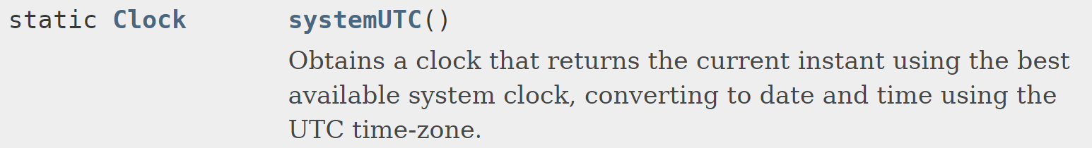
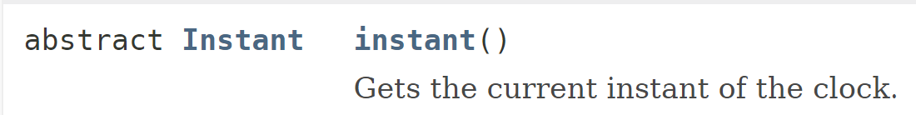
FI[R]ST: Good tests should be [R]epeatable
java.time.Clock
Allows alternate clocks to be plugged in as and when required.
Simplifies testing by modelling a single instantaneous point on the time-line.

Slide 23

FI[R]ST: Good tests should be [R]epeatable
The code we want to test
public class QuestionController {
private Clock clock = Clock.systemUTC();
// ...
public int addBooleanQuestion(String text) {
return persist(new BooleanQuestion(text));
}
void setClock(Clock clock) {
this.clock = clock;
}
// ...
private int persist(Persistable object) {
object.setCreateTimestamp(clock.instant());
executeInTransaction((em) -> em.persist(object));
return object.getId();
}
}
iloveyouboss/16-branch-persistence/src/iloveyouboss/controller/QuestionController.java

Slide 24
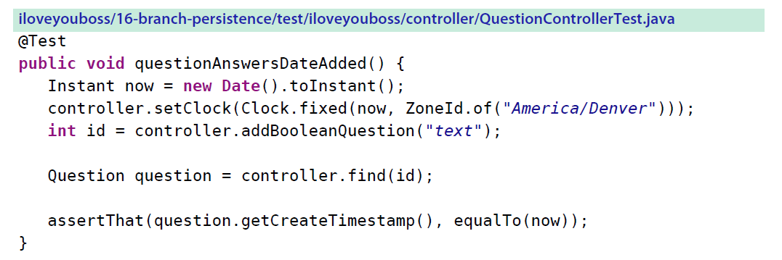
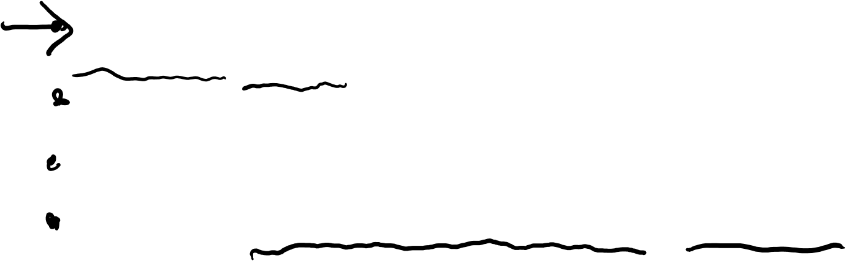
FI[R]ST: Good tests should be [R]epeatable
Creates an Instant instance and stores it in the now local variable.
Injects the now Instant
into the controller via the setter method.
When asked for the time, it will always return the now Instant—because the test previously injected it into the controller through the setter method.

Slide 25
FI[R]ST: Good tests should be [R]epeatable
The persist() method obtains an instant from the injected clock instance and passes it along to the setCreateTimestamp() method.
If no client code injects a Clock instance using setClock(), the clock defaults to the systemUTC clock as initialized at the field level.
Voila! The QuestionController doesn’t know anything about the nature of the Clock, only that it answers the current Instant.
The clock used by the test acts as a test double—a stand-in for the real thing.
private int persist(Persistable object) {
object.setCreateTimestamp(clock.instant());
executeInTransaction((em) -> em.persist(object));
return object.getId();
}

Slide 26
FIRST Principles
Characteristics of quality tests:
[F]ast
[I]solate your tests
[R]epeatable
[S]elf-validating
[T]imely
Source Code: https://pragprog.com/titles/utj2/source_code

Slide 27
FIR[S]T: [S]elf-Validating
Tests aren’t tests unless they assert that things went as expected:
Avoid the temptation to manually verify the results of tests.
Test should also be self-arranging; you must automate any setup your test requires. But remember the [I]solated part of FIRST:
tests requiring external setup (e.g. use of external db) violates [I].
any setup must ensure that you can run any one test at any time, in any order.

Slide 28
FIR[S]T: [S]elf-Validating
For self-validating, the sky’s the limit…as an ideal, imagine a system where:
you write tests for all changes you make.
whenever you integrate the code into your source repository, a build automatically kicks off and runs all the tests (unit and otherwise), indicating that your system is acceptably healthy.
the build server takes that vote of confidence and goes one step further, deploying your change to production.
Embracing such continuous delivery (CD) approaches can significantly reduce the overhead of taking a need from inception to deployed product.

Slide 29
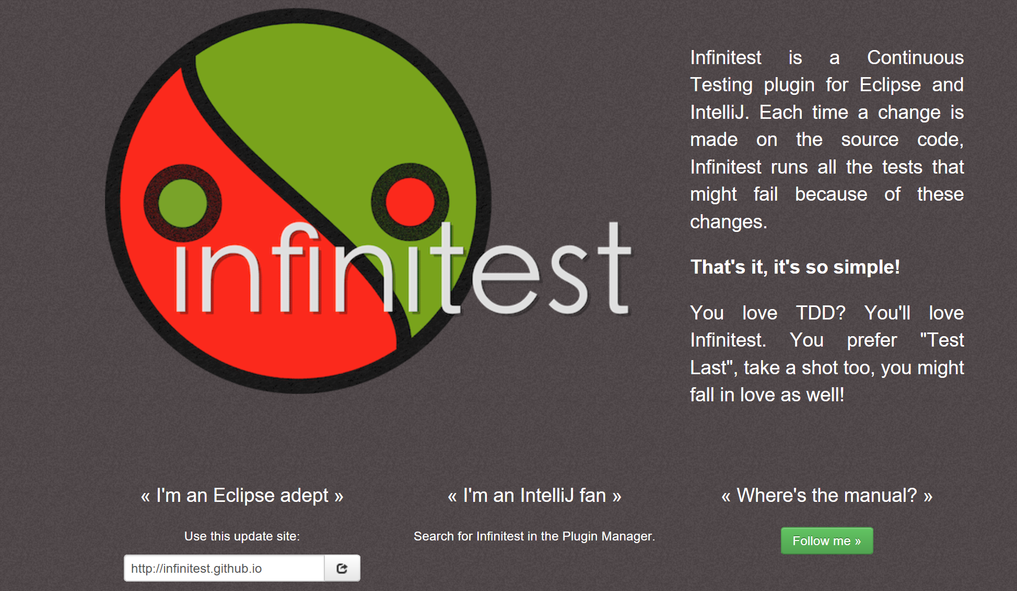
Infinitest tool for IDEs
As you make changes to your system, Infinitest identifies and runs (in the background) any tests that are potentially impacted. With Infinitest, testing moves from being a proactive task to being a gating criterion, much like compilation, that prevents you from doing anything further until you’ve fixed a reported problem.

Slide 30
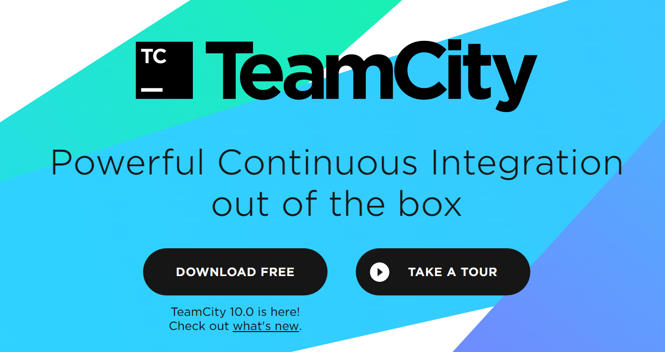
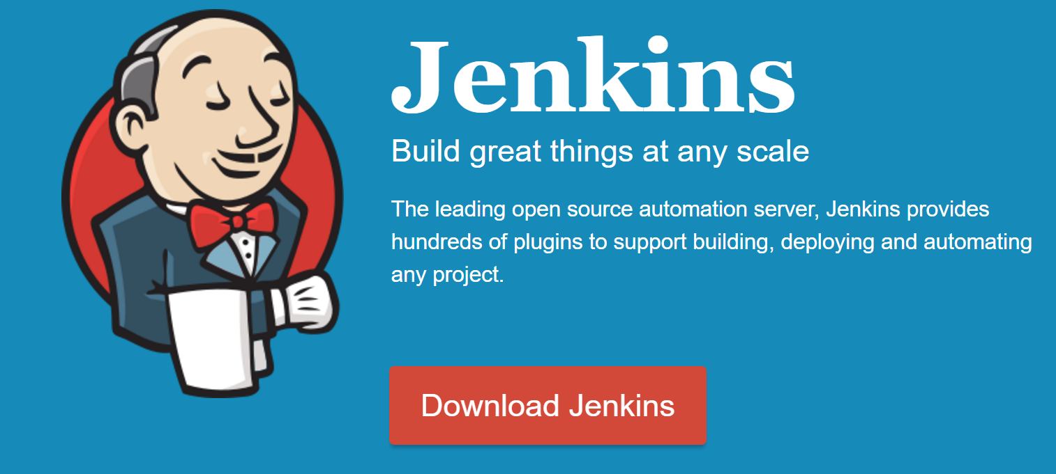
CI Tools – Jenkins, TeamCity
On an even larger scale, you can use a continuous integration (CI) tool such as Jenkins or TeamCity.
A CI tool watches your source repository and kicks off a build/test process when it recognises changes.
https://www.jetbrains.com/teamcity/
Suite of Videos on TeamCity: https://www.jetbrains.com/teamcity/documentation/
http://jenkins-ci.org/

Slide 31
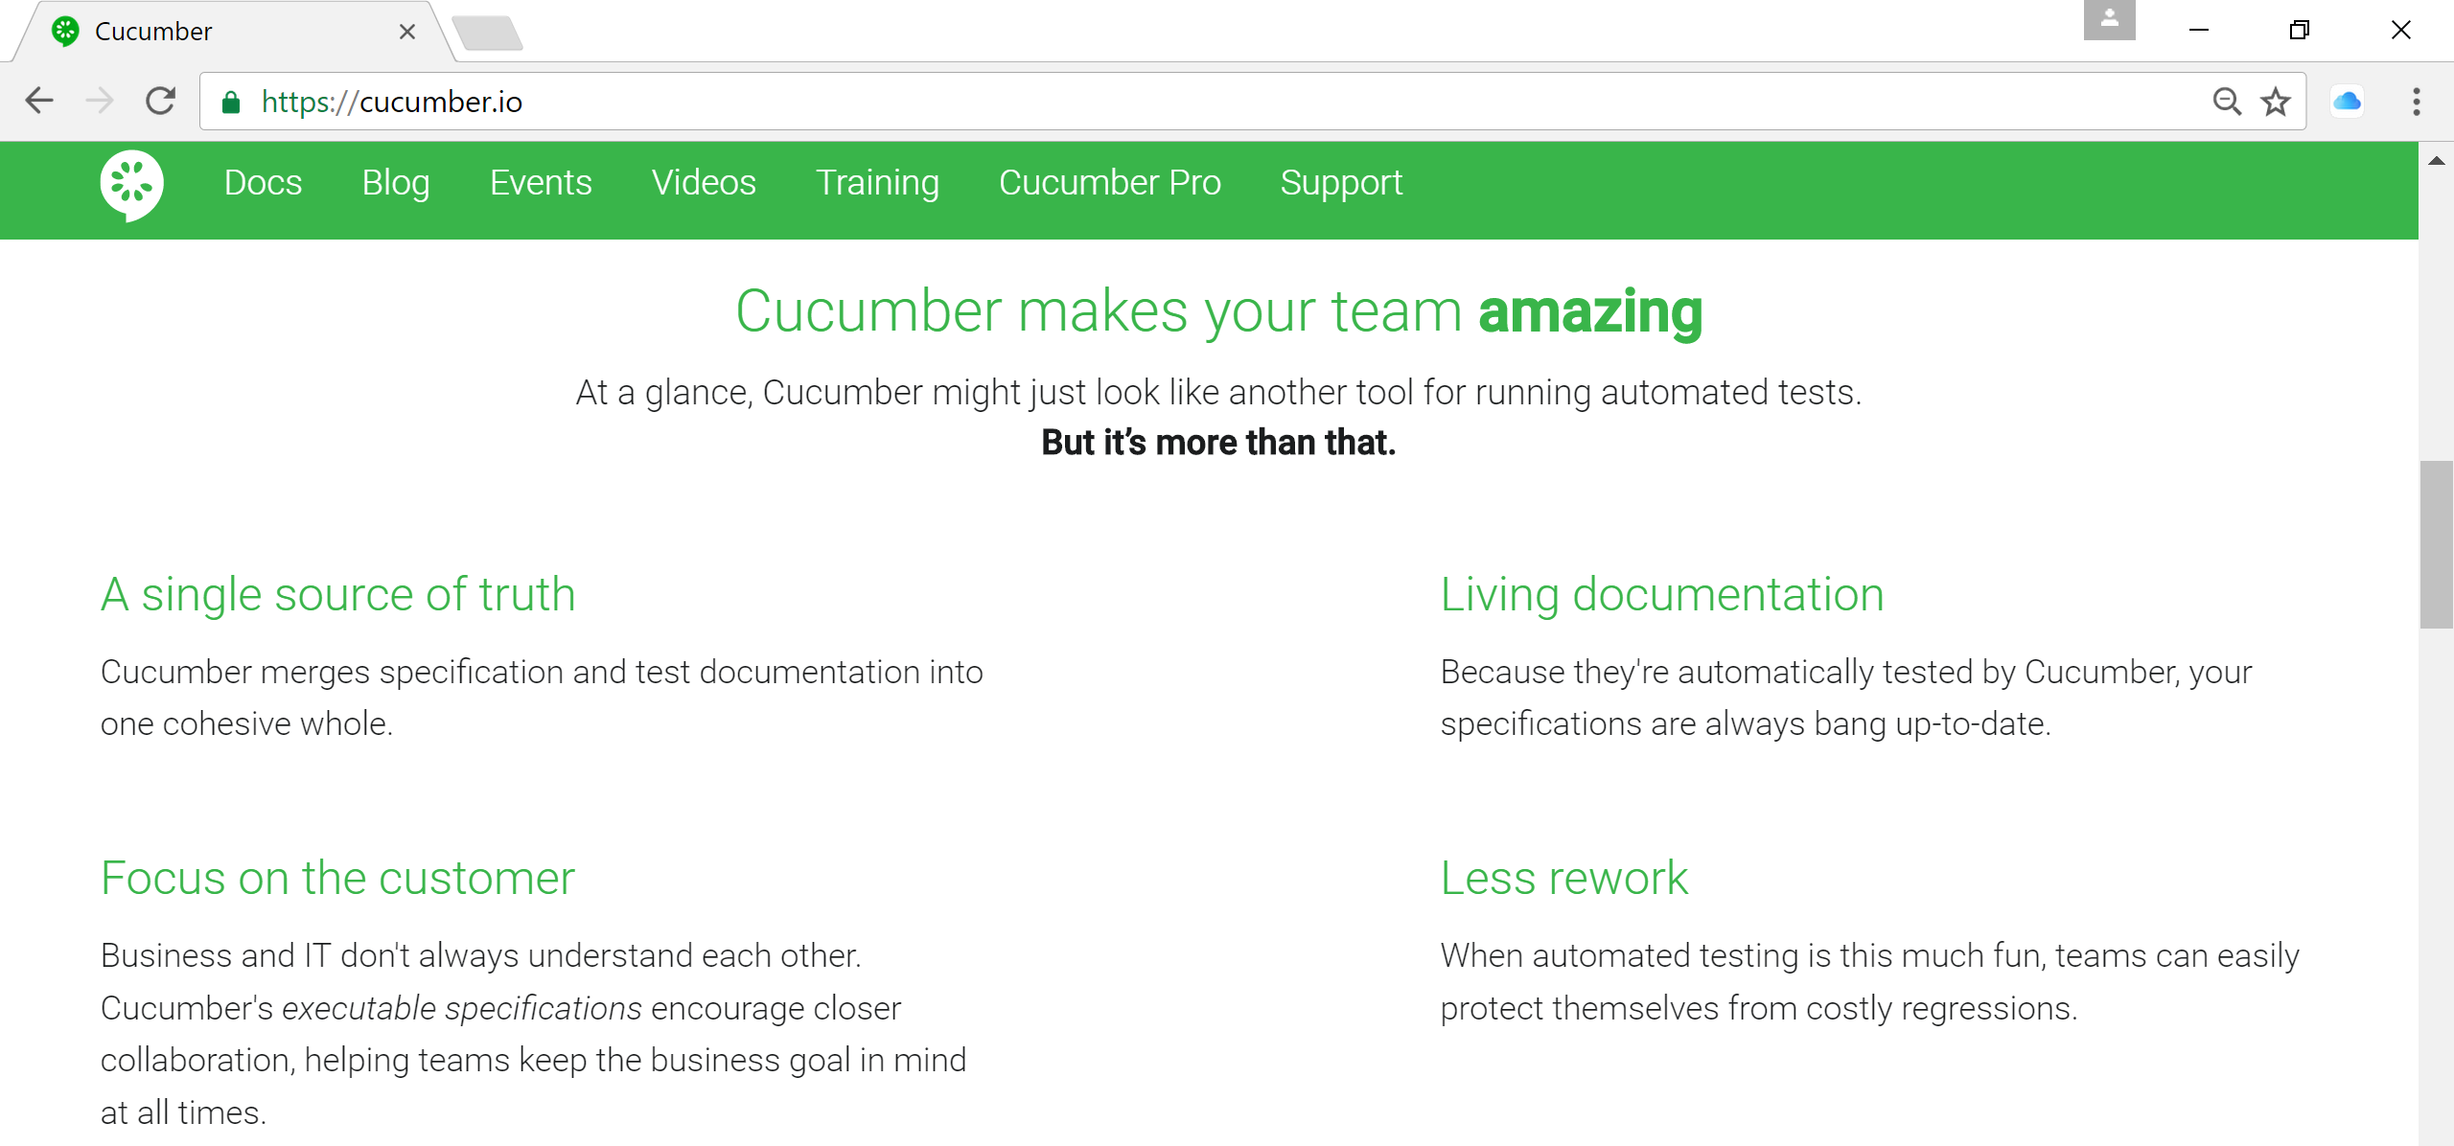
Behaviour Driven Development (BDD) tool
A tool that facilitates BDD: https://cucumber.io/school

Slide 32
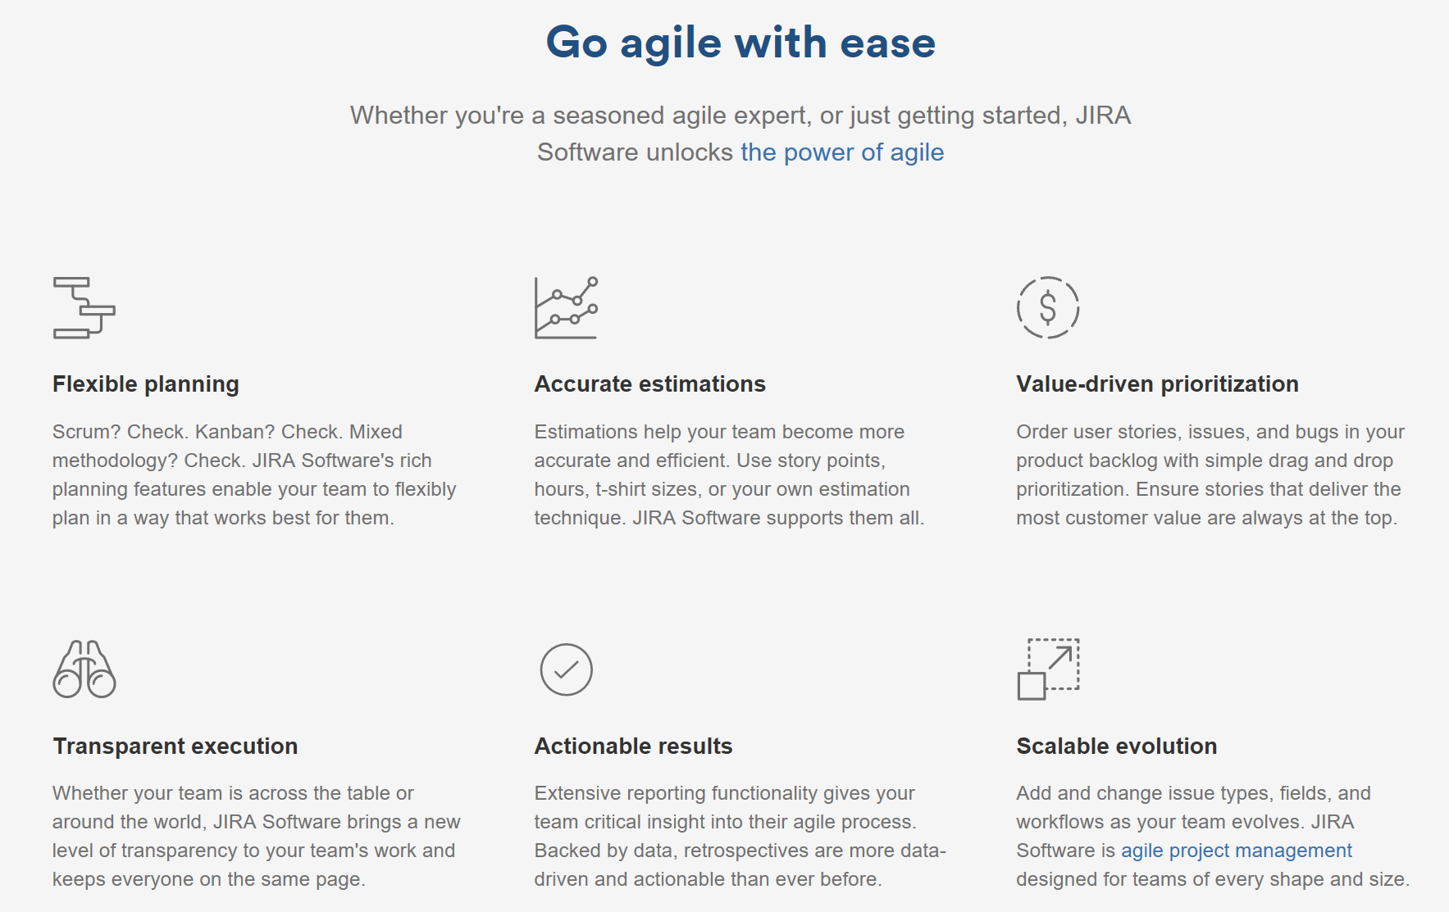
JIRA (https://www.atlassian.com/software/jira)

Slide 33
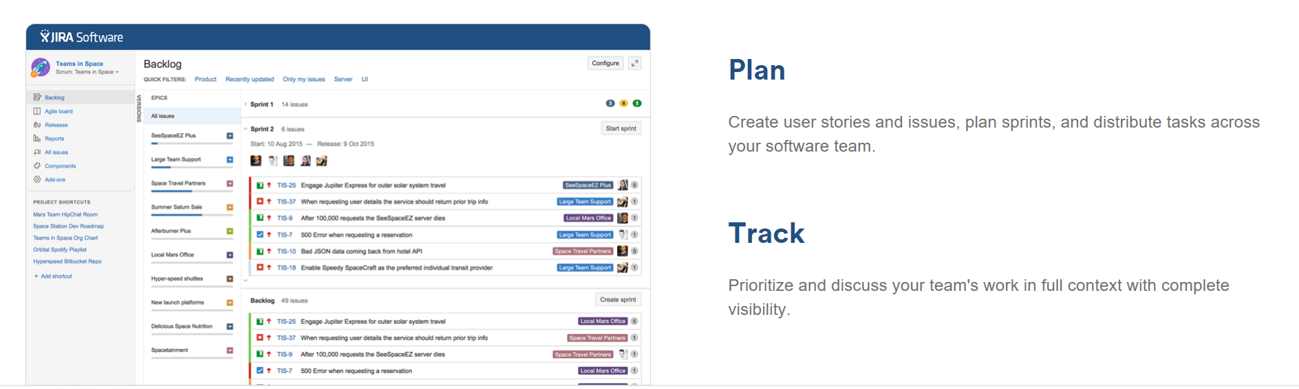
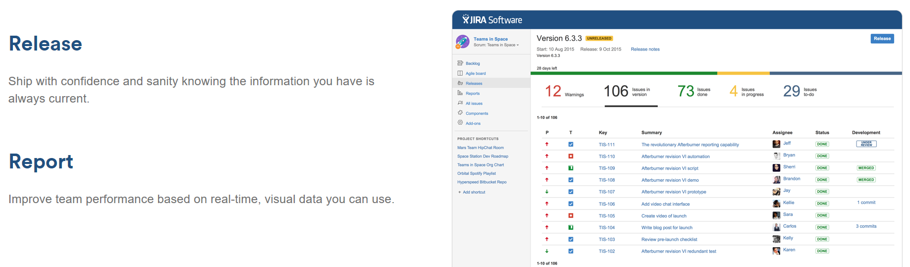
JIRA (https://www.atlassian.com/software/jira)

Slide 34
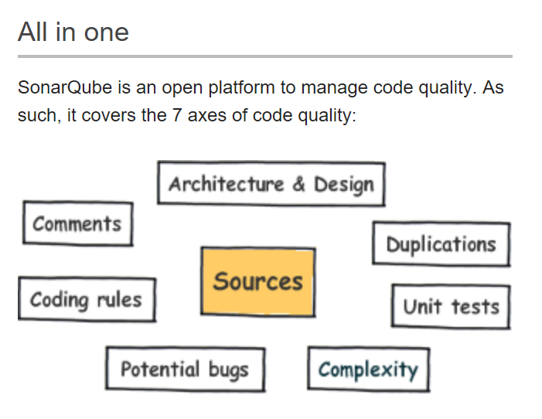
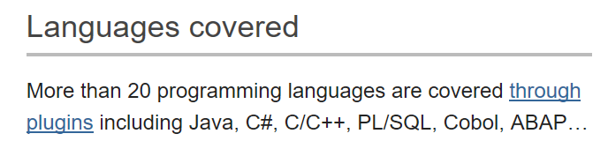
SonarCube (http://www.sonarqube.org/)
SonarCube helps control your Technical Debt.
Wikipedia: Technical debt is "a concept in programming that reflects the extra development work that arises when code that is easy to implement in the short run is used instead of applying the best overall solution.”

Slide 35
FIRST Principles
Characteristics of quality tests:
[F]ast
[I]solate your tests
[R]epeatable
[S]elf-validating
[T]imely
Source Code: https://pragprog.com/titles/utj2/source_code

Slide 36
FIRS[T]: [T]imely
You can write unit tests at virtually any time. You should focus on writing unit tests in a timely fashion.
Many test-infected dev teams have guidelines or strict rules around unit testing. Some use review processes or even automated tools to reject code without sufficient tests.
Keeping atop good practices like unit testing requires continual vigilance.

